Slide 1
CSE 12 – Basic Data Structures and Object-Oriented Design Lecture 8
Greg Miranda, Spring 2021
This lecture is being recorded

Slide 2
Announcements
Quiz 8 due Friday @ 12pm
PA2 due tonight @ 11:59pm
Survey 3 due Friday @ 11:59pm
Exam 1 - week from Friday (Week 4)
Released @ 2pm on Friday
Closes @ 6pm on Saturday
More details to be released on Piazza soon
Lectures 1 – 8
Up to and including PA3

Slide 3
Topics
Questions on Lecture 8?
BFS/DFS

Slide 4
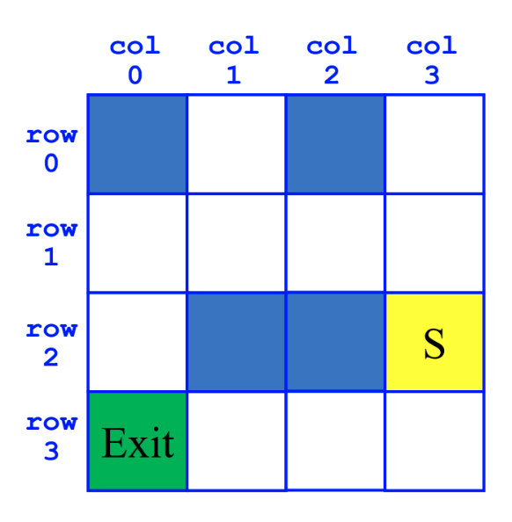
Breadth-First Search (BFS)
SearchForTheExit
Initialize a Queue to hold Squares as we search
Mark starting square as visited
Enqueue starting square on Queue
While Queue is not empty
Dequeue square sq from Queue
Mark sq as visited
If sq is the Exit, we're done!
For each of square's unvisited neighbors (S, W, N, E):
Set neighbor's previous to sq
Enqueue neighbor to Queue

Slide 5
Depth-First Search (DFS)
SearchForTheExit
Initialize a Stack to hold Squares as we search
Mark starting square as visited
Push starting square on Stack
While Stack is not empty
Pop square sq from Stack
Mark sq as visited
If sq is the Exit, we're done!
For each of square's unvisited neighbors (S, W, N, E):
Set neighbor's previous to sq
Push neighbor to Stack

